Slide 1
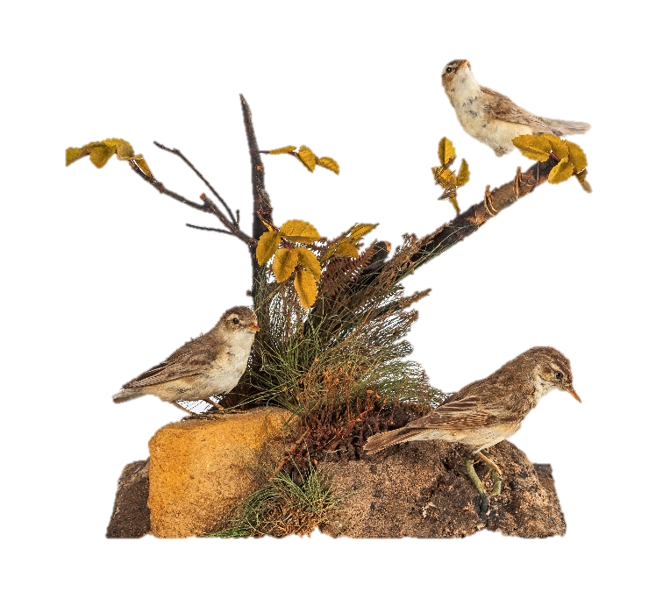
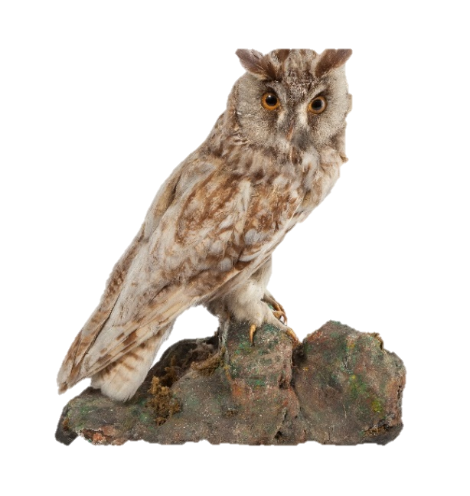
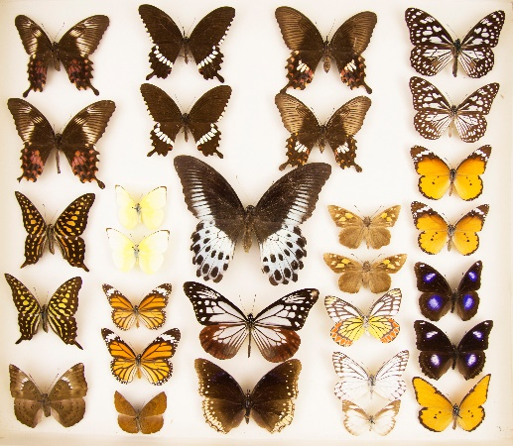
Animals
Long-eared owl
Butterflies
Sedge warblers
Images from Gallery Oldham’s natural history collection.

Slide 2
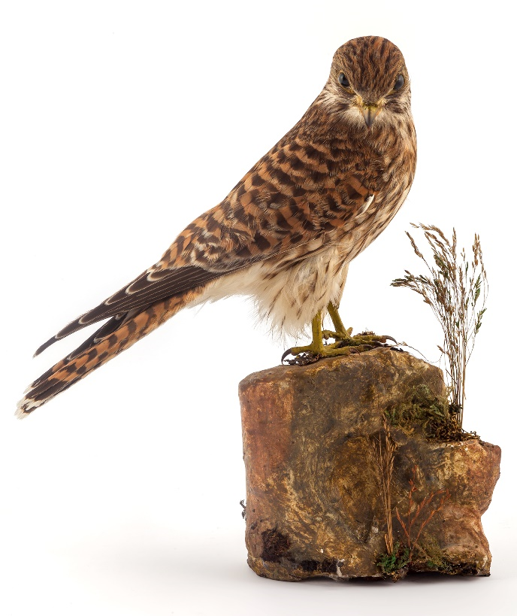
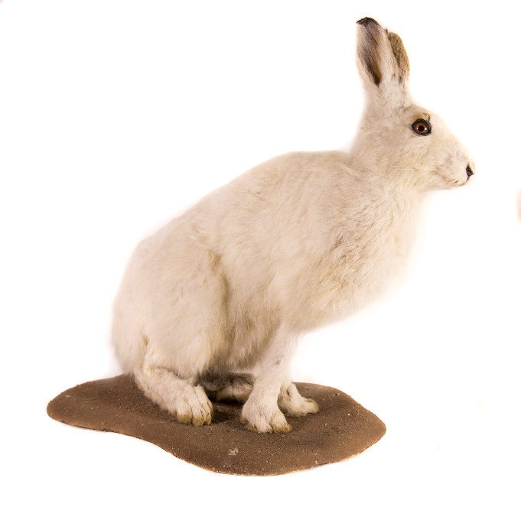
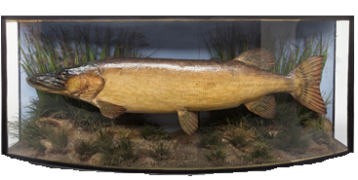
Animals can be classed as invertebrates or vertebrates.
Vertebrate animals include mammals, birds, amphibians, reptiles, or fish. Scientists and natural history curators use their knowledge and observation (looking closely) to group them in this way.
ACTIVITY:
Use observation along with this guide to identify the animal group your pet belongs to. Draw your pet (real or imagined!) and label its features.
Kestrel
Mountain hare
Pike

Slide 3
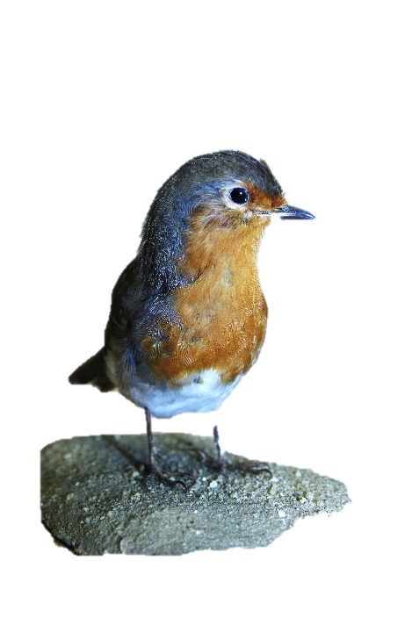
ACTIVITIES:
Within each animal group there are many types. Spend some time observing the different common garden birds that visit your garden, yard or street. See if you can identify them using this guide.
Read this poem about magpies and luck. Count the magpies you can see outside and match the number with the correct poem line to see the prediction!
Can you make up your own counting poem about another type of bird? It doesn’t have to rhyme!
Robin
Collared dove
Magpie, RSPB

Slide 4
ACTIVITY:
Design your own bird. What patterns will its feathers have? What size and shape will its beak be? What will its claws look like? Think about where your bird might live and what it will eat to help you make decisions about its features!
FURTHER RESEARCH:
Find out more about animals and classification here.
Find out how we can help birds, bees and butterflies visit the garden here and here.
Find out about Gallery Oldham’s natural history collection here.
Share with us your bird counting poems, and the birds you have designed via email librariesandgalleryschools@oldham.gov.uk or social media: Gallery Oldham @GalleryOldham @galleryoldham

