Slide 1
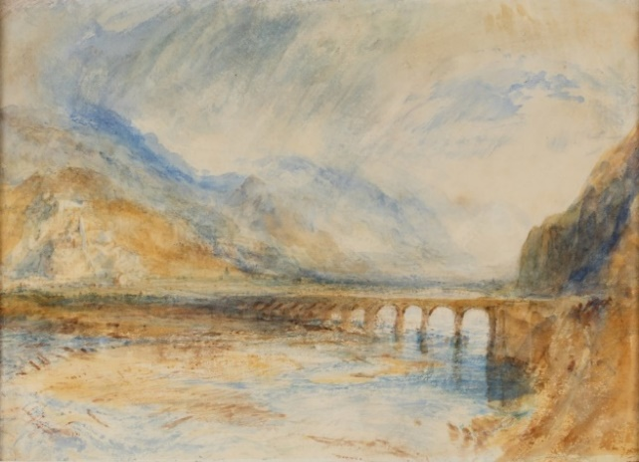
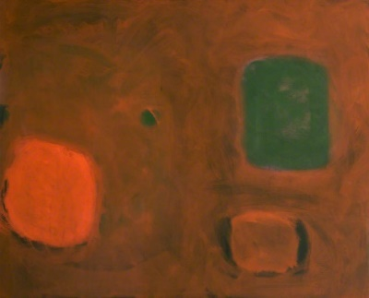
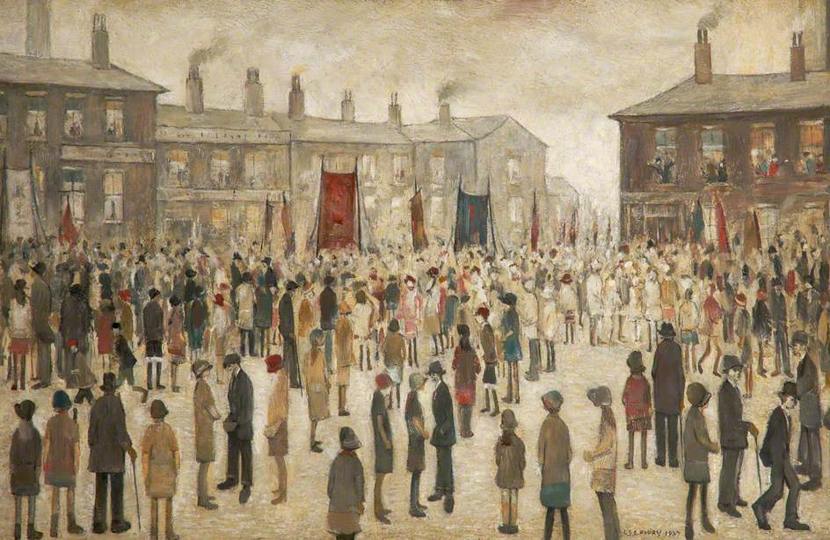
Famous Artists
Bellinzona – The Bridge over Ticino (previously 'The Bridge over Moselle’), Joseph Mallord William Turner
Scarlet and Green in Brown,
November, 1961, Patrick Heron
The Procession, Laurence Stephen Lowry
Images by Gallery Oldham and Art UK.

Slide 2
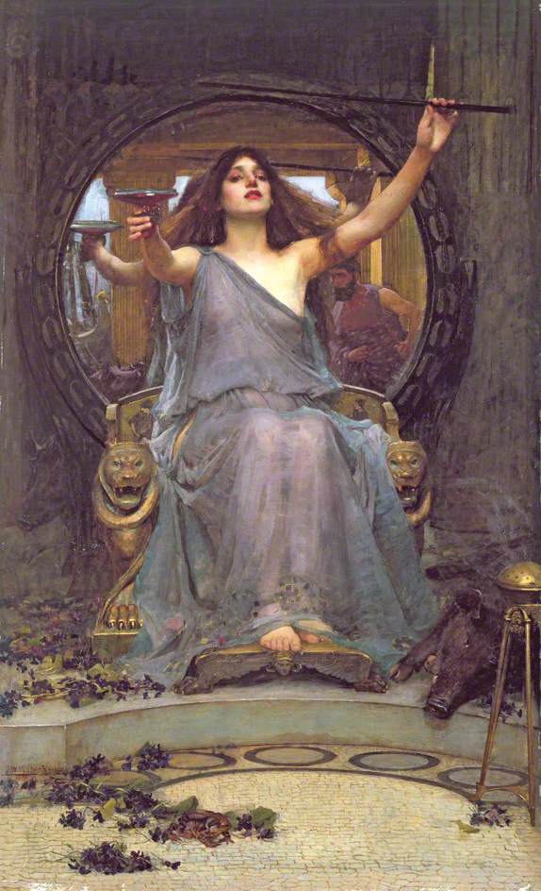
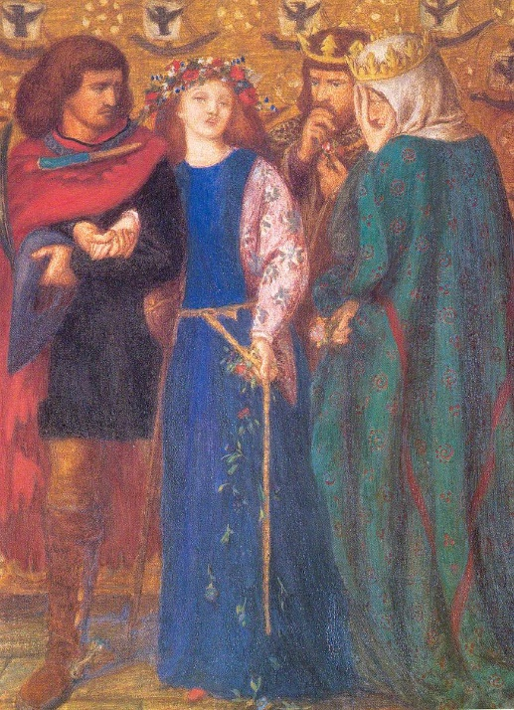
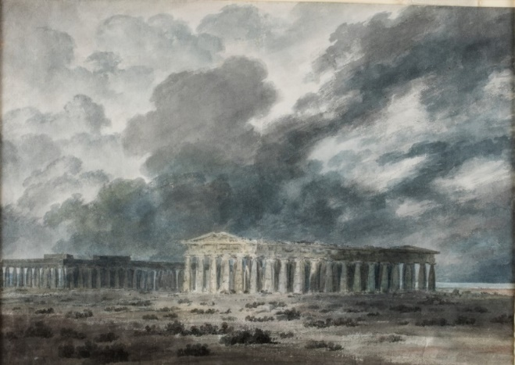
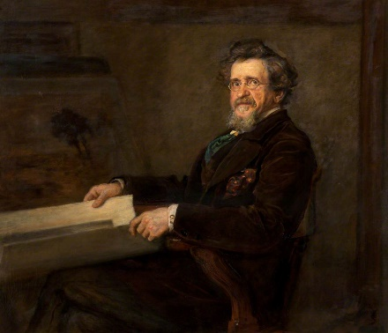
Being “famous” is not a fixed thing. If you grew up in Britain, you may have heard of European artists like Salavador Dali and Claude Monet. If you grew up in Indonesia, you would have learnt about different famous artists at school.
Fame also changes as time moves on. People may gain sudden fame and famous people may be remembered or forgotten.
When we are talking about “famous” artists it doesn’t mean they are better than other artists, simply that they have been given more attention.
The First Madness of Ophelia (also known as 'Horatio Discovering the Madness of Ophelia’),
Dante Gabriel Rossetti
Circe, John William Waterhouse
Thomas Oldham Barlow, John Everett Millais
Two Great Temples at Paestum,
John Robert Cozens

Slide 3
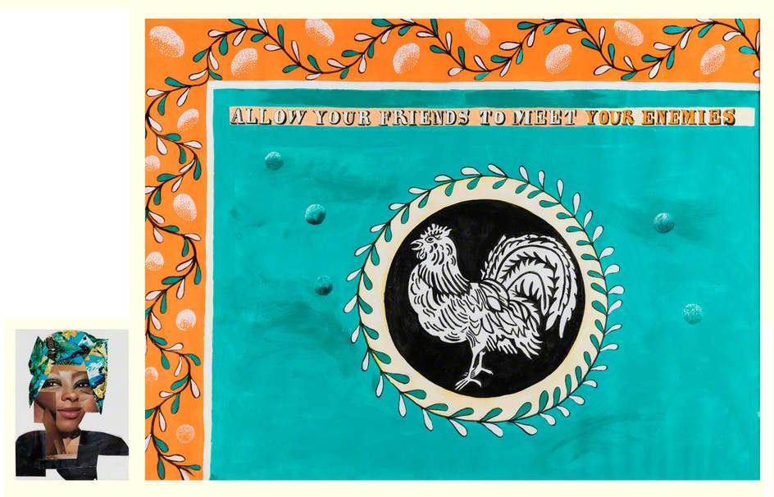
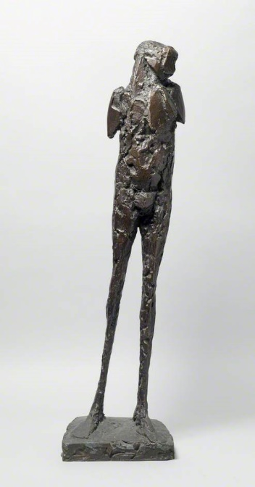
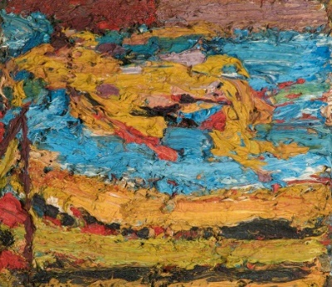
A lot of artists who have been called “famous” are men. For much of history, men have labelled other men as important or famous.
Over the last 50 years, people have challenged this by giving more attention to other artists – women, BAME (black, Asian and minority ethnic) artists, people with disabilities and so on.
ACTIVITY:
Who is somebody famous you admire? Research their work and achievements. Share your knowledge by telling somebody in your household about them.
Allow Your Friends to Meet Your Enemies (diptych, right and left panel), Lubaina Himid
E.O.W. on Her Blue Eiderdown, Frank Helmuth Auerbach
Birdman, Elisabeth Frink

Slide 4
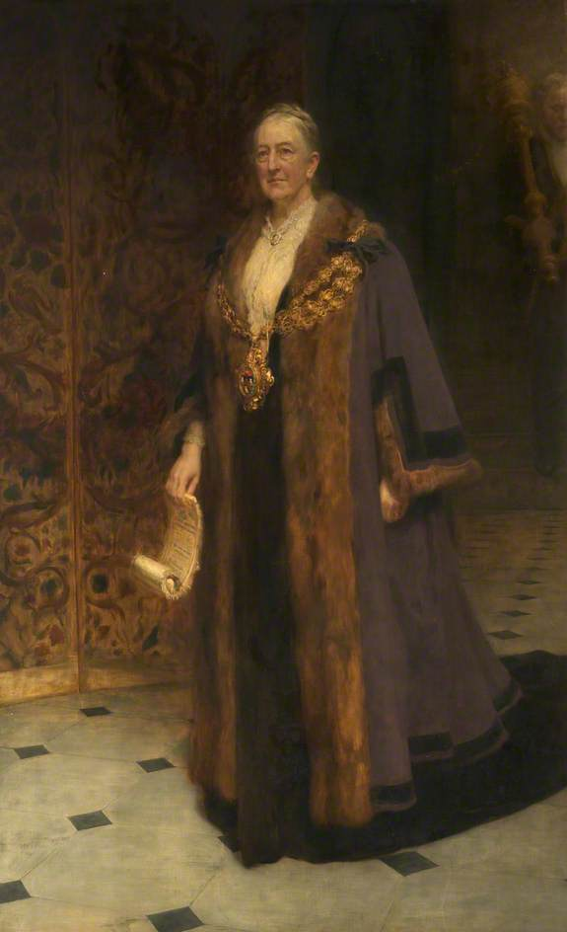
ACTIVITY:
This painting is a portrait of Dame Sarah Lees, a famous Oldhamer, by the famous portrait artist Hugh Goldwin Riviere. Make a portrait of someone you know or create a self-portrait (a picture of yourself) using pencils, paint, crafts, or found objects or take a photo.
FURTHER RESEARCH:
Discover more about the famous artists featured in this resource online using Art UK and other web sources. Type in their names and see what you can find out!
Explore the famous artists featured in Gallery Oldham’s collection by refining your search by venue.
Dame Sarah Lees (1842-1935), Hugh Goldwin Riviere
Share your favourite famous artists and famous people and your portraits or self-portraits via librariesandgalleryschools@oldham.gov.uk or social media: Gallery Oldham @GalleryOldham @galleryoldham

