Slide 1
Lubaina Himid
Allow Your Friends to Meet Your Enemies (diptych, right and left panel), Lubaina Himid
Images by Gallery Oldham and Art UK.

Slide 2
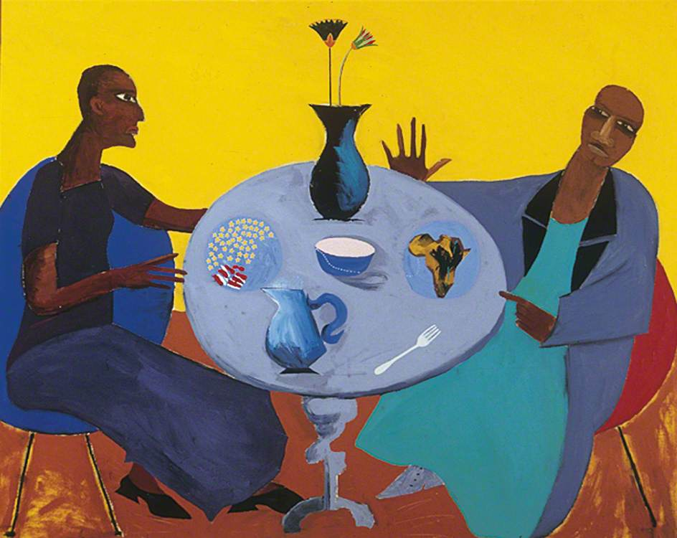
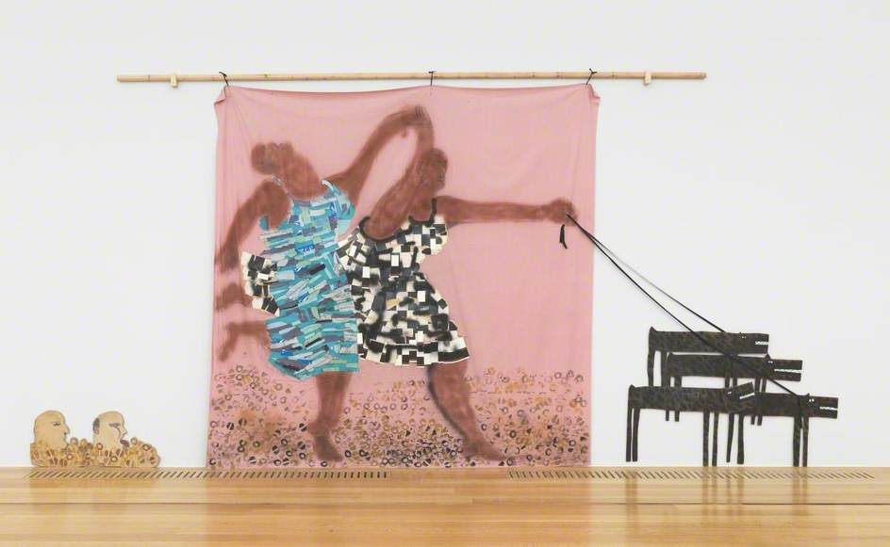
Lubaina Himid CBE (born 1954 in Zanzibar, Tanzania) is a British artist, curator and professor. Her art focuses on cultural history, figures, and identity; in particular silenced histories and aspects of contemporary life.
Himid creates paintings, drawings, prints and installations, often making objects intended to be viewed in a space and encouraging conversation.
Her work highlights the contribution black people have made and are still making to cultural life and history.
Five, Lubaina Himid
Freedom and Change, Lubaina Himid

Slide 3
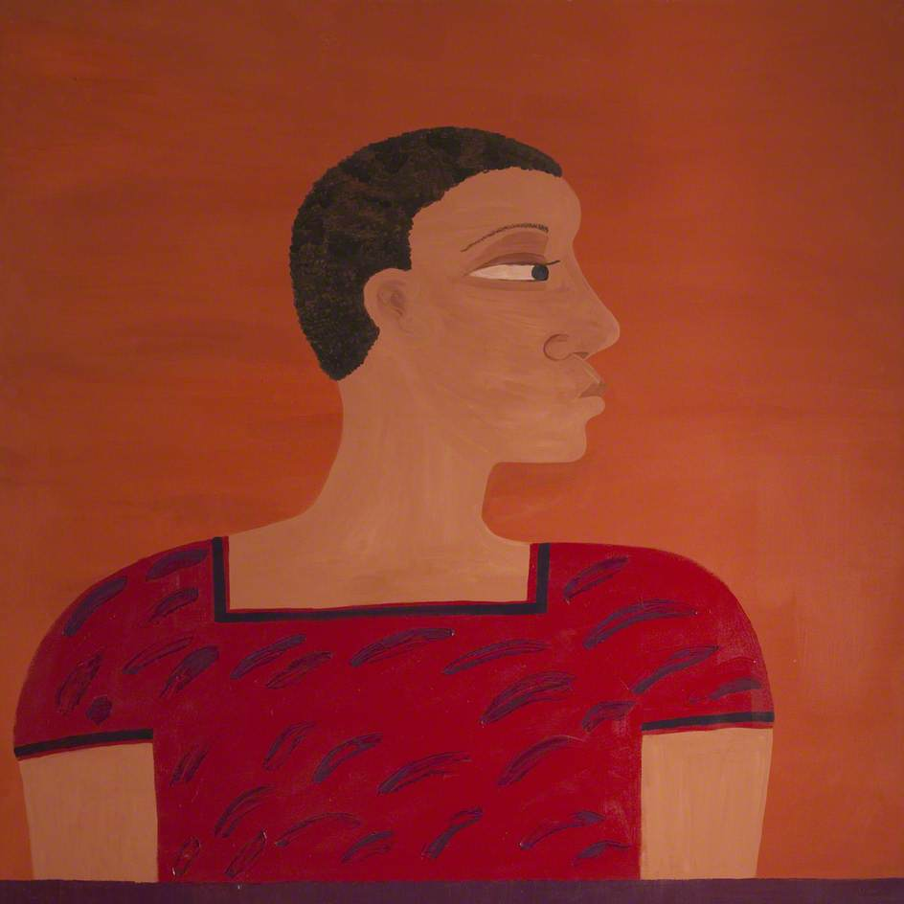
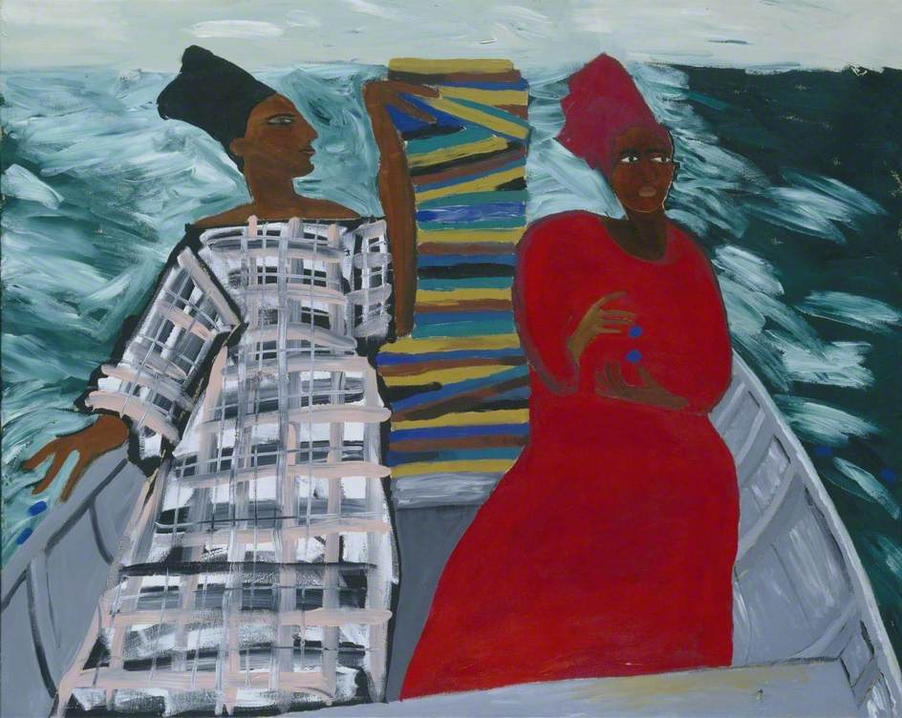
Himid was one of the first artists involved in the UK's Black Arts Movement in the 1980s. This was a political art movement which worked to challenge the mainstream art world's favouritism towards white, male artists.
The Blk Art Group highlighted issues of race, gender and representation in the art world. By bringing attention to the lack of inclusion of black artists, the group disrupted what British art was considered to be.
The Black Arts Movement and Himid helped to make space for black artists, black experience and expression, and women’s creativity.
Hannibal ‘s Sister, Lubaina Himid
Between the Two my Heart is Balanced, Lubaina Himid

Slide 4
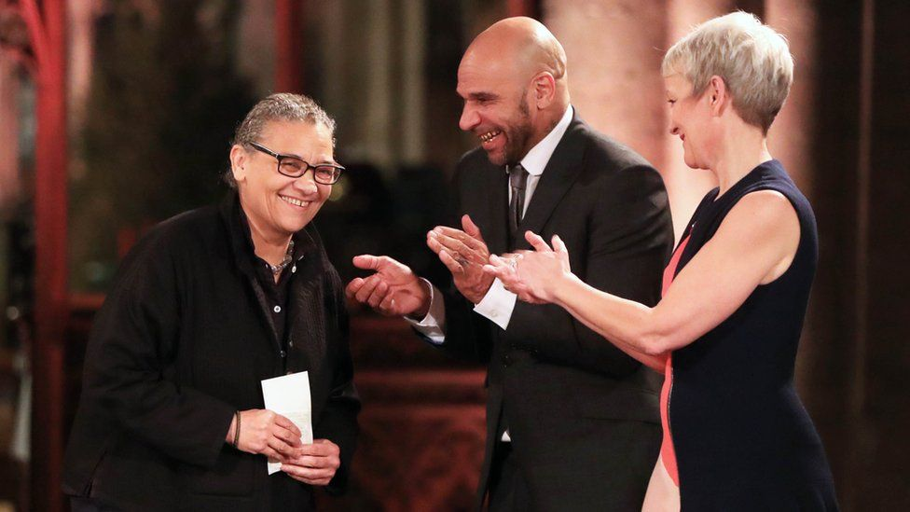
Lubaina Himid has earned international recognition for her work. In 2017 she was awarded the Turner Prize. In 2018 she was given the title of CBE for her contributions to the arts.
Allow Your Friends to Meet Your Enemies is an artwork by Lubaina Himid that Gallery Oldham looks after in its collection.
The painting on the right is a Kanga. Kanga's are worn by women in Tanzania and Kenya. They often feature patterns and motifs and traditional Swahili sayings on them. "Allow your friends to meet your enemies" is one of Himid's own sayings.
Lubaina Himid wins the Turner Prize 2017 (copyright BBC)
Allow Your Friends to Meet Your Enemies (diptych, right and left panel), Lubaina Himid

Slide 5
The collaged portrait on the left of the painting is a woman wearing the Kanga. Himid’s kangas are also about the women who wear them.
Allow Your Friends to Meet Your Enemies is part of a series of artworks by Himid. They explore the historical relationship between the textile industry in Greater Manchester, including Oldham, and African people – the movement of cultures and products, and related trauma.
Gallery Oldham has been and continues working to diversify its collection so it represents a broader history and group of people, artists, stories, and voices.
Allow Your Friends to Meet Your Enemies (detail), Lubaina Himid
Oldham Panorama, 1876

