Slide 1
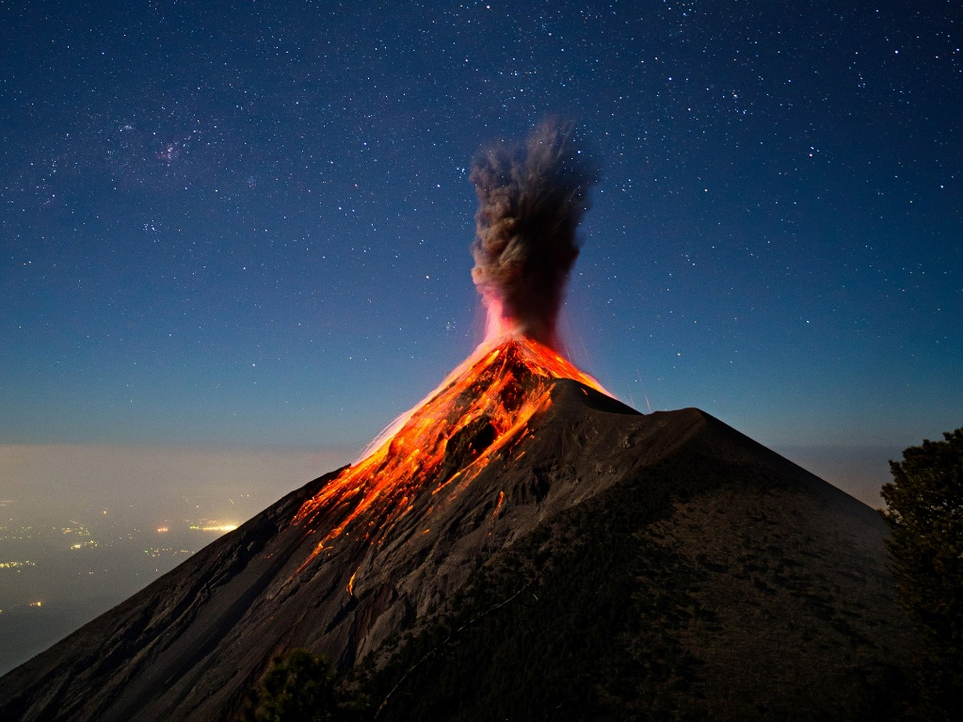
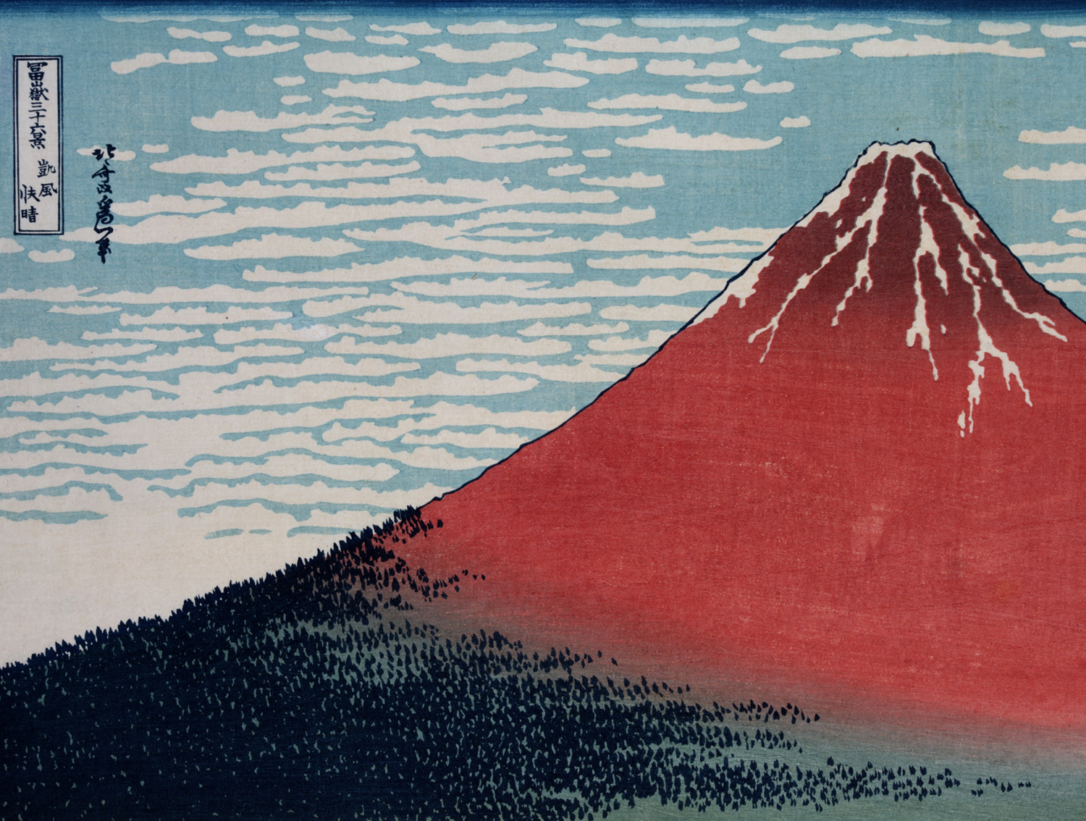
Volcanoes
Mount Fuji, Katsushika Hokusai, Blackburn Museum & Art Gallery.

Slide 2
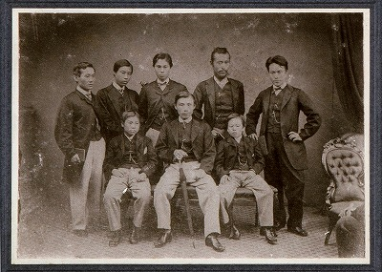
Oldham has strong industrial links to Japan, a country with over 100 active volcanoes!
In 1865, a group of Japanese students visited Oldham to look at our cotton mills and their machinery. The trip leader, Godai Tomoatsu, bought equipment from Oldham company Platt Brothers, and used this to set up the first modern textile factory in Kagoshima in 1866.
Four engineers from Platt Brothers travelled to Japan from Oldham to help install the machinery and train workers. Discover more about the Satsuma students, Platt engineers and Oldham and Japan’s trade links here.
Platt Brothers & Co. machinery invention book
Japanese students from Satsuma who visited Oldham in 1865

Slide 3
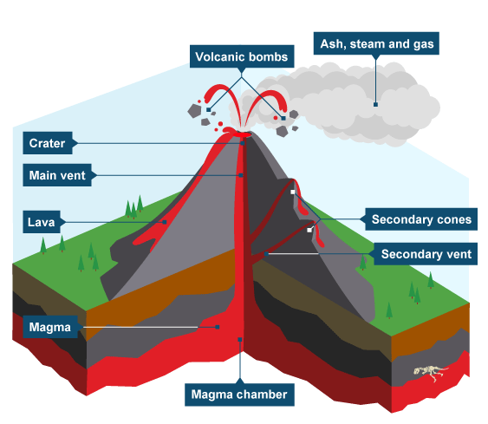
A volcanic eruption happens when magma (melted rock) inside the earth rises due to pressure caused by heat and gas and comes out of the earth’s surface as lava. Learn more about a volcanic eruption here.
Rocks are formed by the lava as it cools and they are thrown out of the volcano as volcanic bombs during an eruption. Gallery Oldham’s collection incudes real volcanic rocks!
Ash also comes out of volcanoes. See how people in Kagoshima cope with volcanic ash and discover how the Sakurajima volcano was formed here.
Volcano, BBC Bitesize

Slide 4
ACTIVITY:
Make your own volcanic eruption using coke and mints! Follow the instructions to see in action carbon dioxide push the liquid out of the bottle, just as gas causes the volcano’s magma to rise and erupt. You must do this experiment with an adult and use an outdoor space without a roof – a garden, yard or drive way would work!
ACTIVITY:
Make you own volcanic eruption sound. Think about the building pressure and the dramatic ending! Record your sound and play it back as your coke and mint experiment builds and erupts, or play it live. Use pots and pans, wooden spoons and other items found around your home to make a creative soundtrack!
Share with us photos or videos of your volcanic experiment, and audios of your eruption sound via librariesandgalleryschools@oldham.gov.uk or social media: Gallery Oldham @GalleryOldham @galleryoldham

