Slide 1
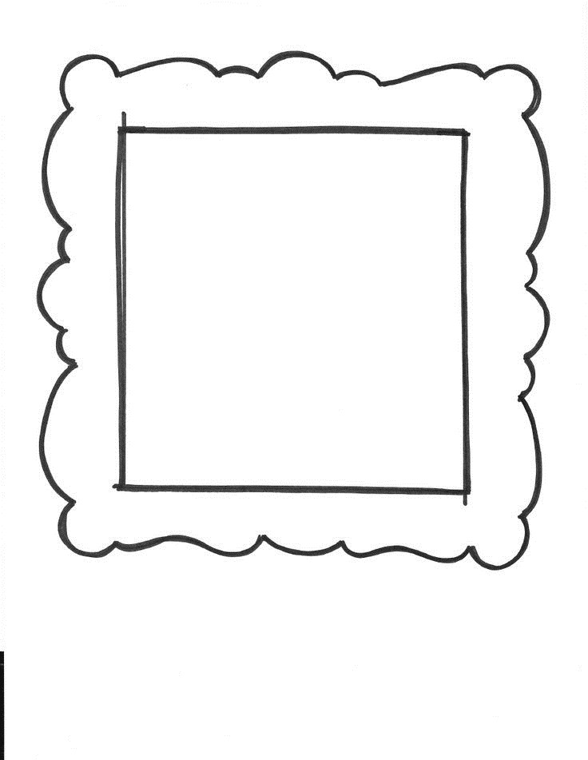
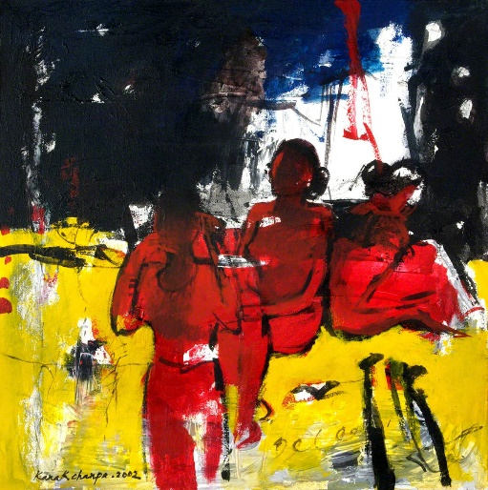
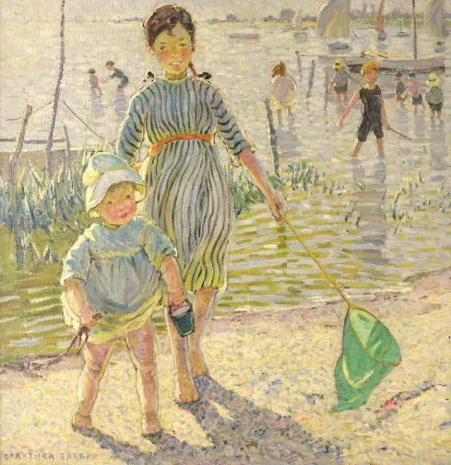
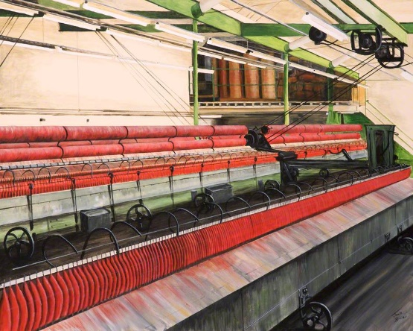
Women Artists
In the Red, Kanak Chanpa Chakma
Spinning Mules 3 and 4, Janis Bowie
Paddlers, Dorothea Sharp
Images by Gallery Oldham and Art UK.

Slide 2
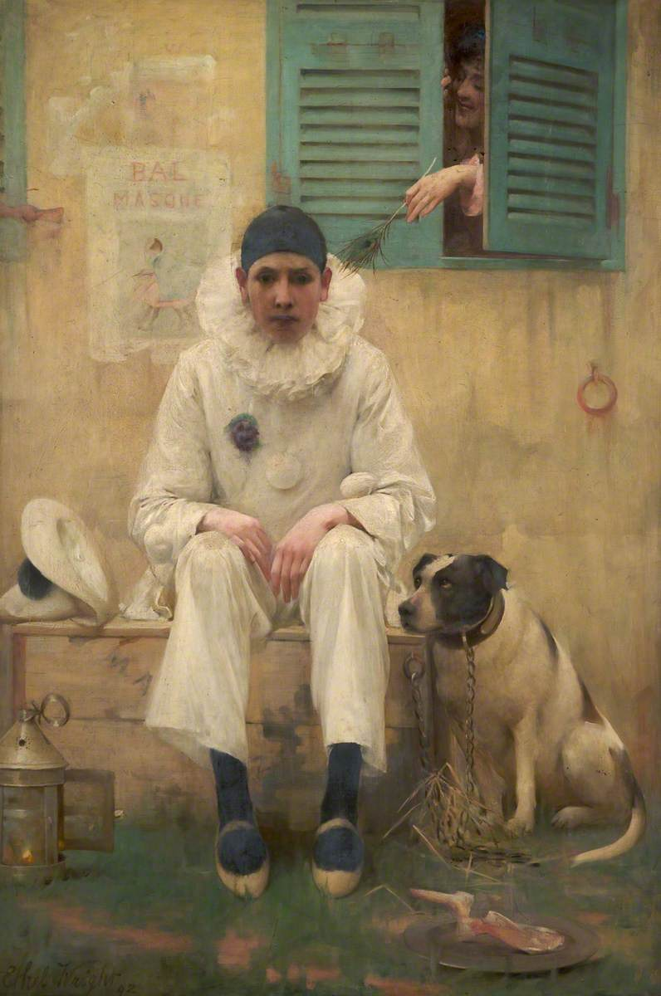
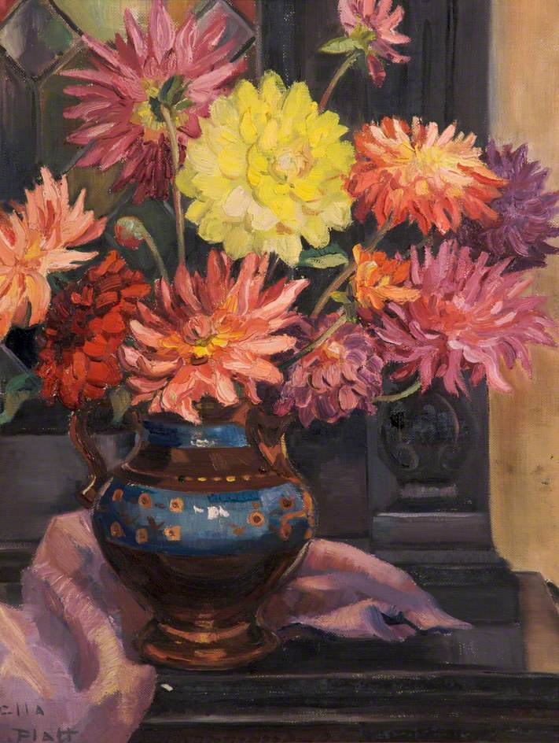
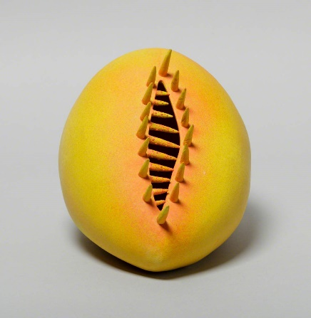
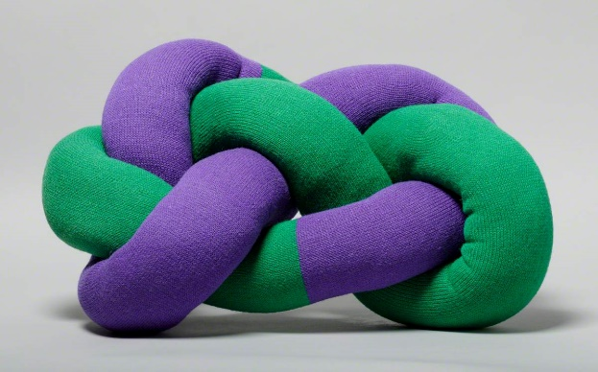
For many hundreds of years, men were paying artists to make art, deciding which art to buy, and deciding which art could be shown in and bought by museums.
Most of the artists were men, because women were expected to be at home having children and looking after the house.
There were women artists, but for a long time it was harder for them to find chances to show their art.
Later, male art historians wrote about male artists but most of them ignored women artists. People assumed the term “artist” referred to a man.
Flowers (recto), Stella Platt
Bonjour, Pierrot!, Ethel Wright
Small Mollington Knot Cushion, Ann Sutton
Spikey Orange, Catrin Mostyn Jones

Slide 3
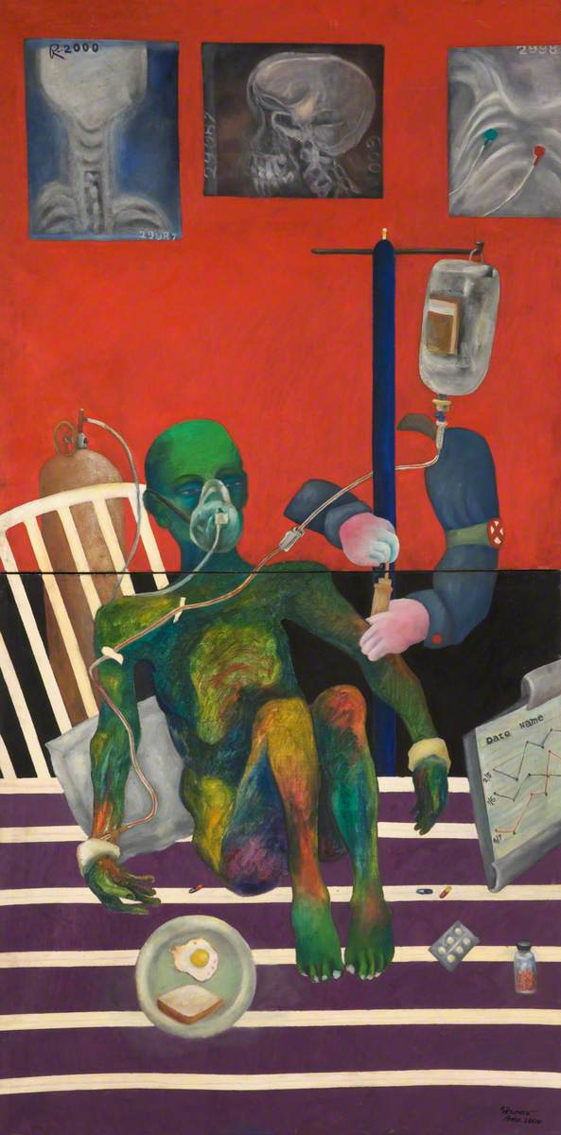
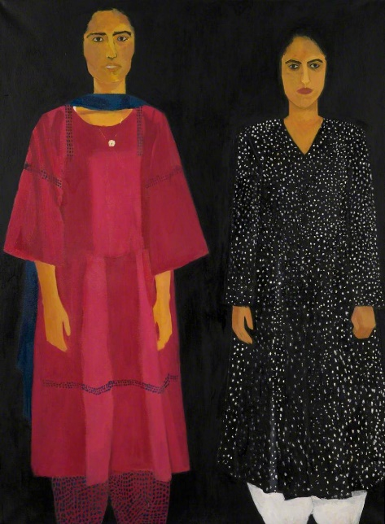
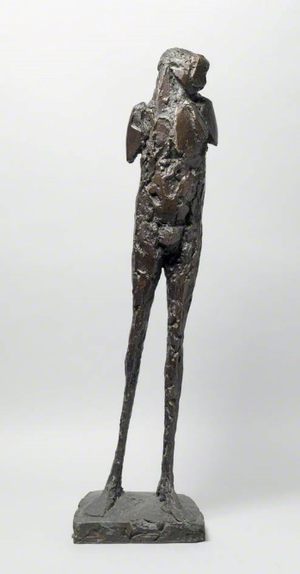
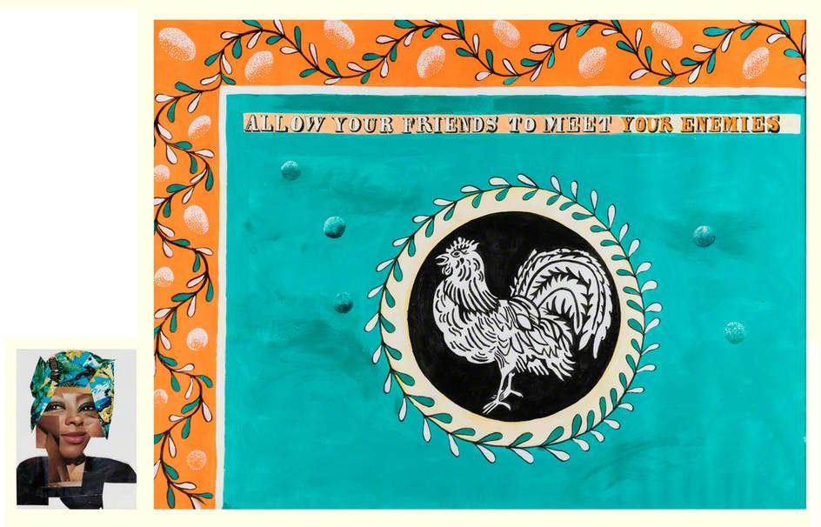
By selecting a group of women artists in our collection for this resource, we are highlighting the hard work of women making art.
We are still interested in the history of male artists as well. We just want to hear more voices and different stories.
ACTIVITY:
Research the women artists and their artworks in this resource using Art UK and other sources online. Then choose one artist. What stands out to you about their work and life? Write an article to promote them!
Portrait of Two Sisters, Aneela Majid
Insulin, Atia Islam Anne
Allow Your Friends to Meet Your Enemies (diptych, right and left panel), Lubaina Himid
Birdman, Elisabeth Frink

Slide 4
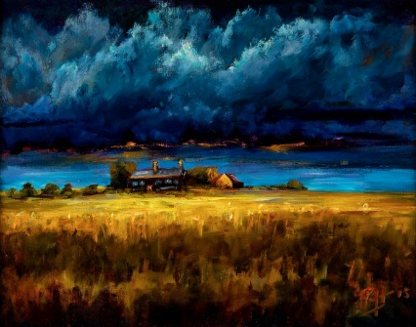
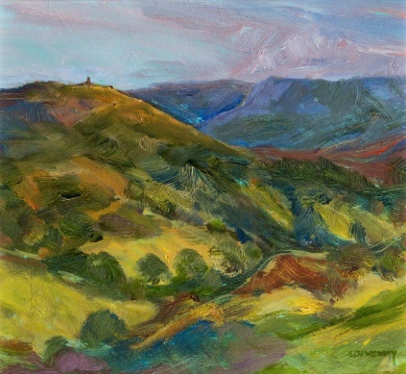
ACTIVITY:
These paintings by women artists Joyce Parfitt and Shelia Dewsbury are of Oldham’s landscapes. Make your own landscape artwork of a place near you, an imagined site, or your garden view! Draw it, paint it, or recreate it with fabrics or found objects around your home.
ACTIVITY:
What can you find out about the woman artist Annie Maycock and her work? You may not be able to find much information! Gallery Oldham’s collection includes some paintings of her. Here she is on her wedding day after which she had to give up her career.
Clouds over Denshaw Farm, Joyce Parfitt
Saddleworth Hills, Dusk, Sheila Dewsbury
Share a woman artist you like or admire, your artist articles and your landscape artworks via librariesandgalleryschools@oldham.gov.uk or social media: Gallery Oldham @GalleryOldham @galleryoldham

